Slide 1


Windows Server 2019
By Brian Kilburn and Aaron Voynar

Slide 2
Hybrid Integration
What is Hybrid Integration?

Slide 3
Hybrid Integration
What is Hybrid Integration?
Combination of Admin Center with Azure Extensions

Slide 4
Hybrid Integration
What is Hybrid Integration?
Combination of Admin Center with Azure Extensions
Storage Migration Service

Slide 5
Hybrid Integration
What is Hybrid Integration?
Combination of Admin Center with Azure Extensions
Storage Migration Service
File Sync with Azure

Slide 6
Hybrid Integration
What is Hybrid Integration?
Combination of Admin Center with Azure Extensions
Storage Migration Service
File Sync with Azure
Storage Replica

Slide 7
Azure Services
SaaS (Software as a Service)

Slide 8
Azure Services
SaaS (Software as a Service)
PaaS (Platform as a Service)

Slide 9
Azure Services
SaaS (Software as a Service)
PaaS (Platform as a Service)
IaaS (Infrastructure as a Service)

Slide 10
Storage Migration Features
Transfer of Data from legacy systems to WS2019
Notes:
Transfers from windows server 2008, 2012,2016 legacy systems

Slide 11
Storage Migration Features
Transfer of Data from legacy systems to WS2019
easy setup of a point-to-point VPN to the Azure services

Slide 12
System Insights
System Monitoring Capabilities

Slide 13
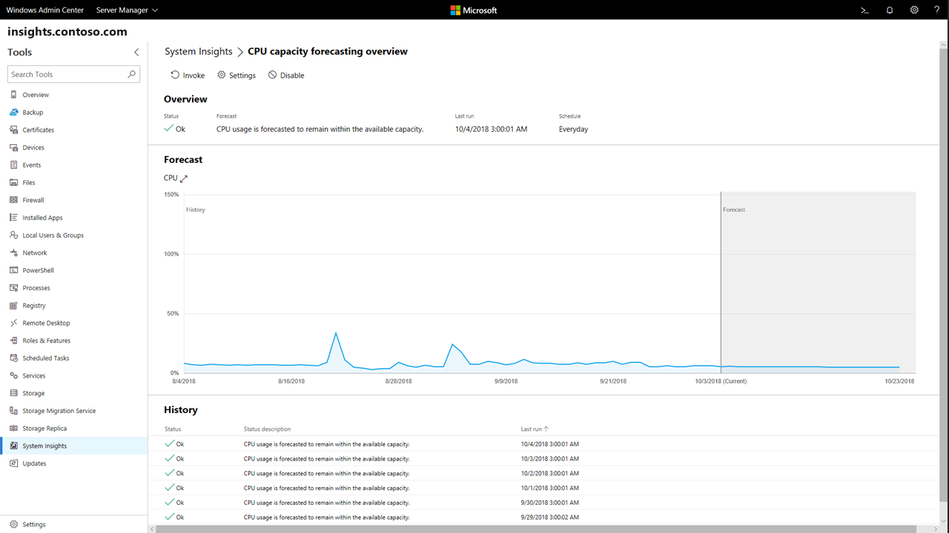
System Insights
System Monitoring Capabilities
Shows System Insights CPU Capacity Forecast
https://docs.microsoft.com/en-us/windows-server/manage/system-insights/overview

Slide 14
Infrastructure Features
Enhanced Storage Spaces Direct (S2D)

Slide 15
Infrastructure Features
Enhanced Storage Spaces Direct (S2D)
4PB (petabyte) of storage in a storage pool and 64TB (terabyte) of storage per volume
Notes:
4 quadrillion, 64 trillion

Slide 16
Infrastructure Features
Enhanced Storage Spaces Direct (S2D)
4PB (petabyte) of storage in a storage pool and 64TB (terabyte) of storage per volume
Storage Health Monitoring

Slide 17
Infrastructure Features
Enhanced Storage Spaces Direct (S2D)
4PB (petabyte) of storage in a storage pool and 64TB (terabyte) of storage per volume
Storage Health Monitoring
Storage Quality of Service (QoS)

Slide 18
Infrastructure Features
Enhanced Storage Spaces Direct (S2D)
4PB (petabyte) of storage in a storage pool and 64TB (terabyte) of storage per volume
Storage Health Monitoring
Storage Quality of Service (QoS)
Uses configurable policies to ensure consistent performance to VMs.

Slide 19
Security Features
Windows Defender Advanced Threat Protection (ATP)

Slide 20
Security Features
Windows Defender Advanced Threat Protection (ATP)
Host-Intrusion Prevention tools

Slide 21
Security Features
Windows Defender Advanced Threat Protection (ATP)
Host-Intrusion Prevention tools
Attack Detection

Slide 22
Security Features
Windows Defender Advanced Threat Protection (ATP)
Host-Intrusion Prevention tools
Attack Detection
Zero-Day exploit monitoring

Slide 23
Security Features
Windows Defender Advanced Threat Protection (ATP)
VMs Shielding

Slide 24
Security Features
Windows Defender Advanced Threat Protection (ATP)
VMs Shielding
VM to VM data traffic encryption

Slide 25
Security Features
Windows Defender Advanced Threat Protection (ATP)
VMs Shielding
VM to VM data traffic encryption
Secure console connection to interact with shielded VMs

Slide 26
Security Features
Windows Defender Advanced Threat Protection (ATP)
VMs Shielding
Device Guard

Slide 27
Security Features
Windows Defender Advanced Threat Protection (ATP)
VMs Shielding
Device Guard
Integrity protocol to help ensure programs are authorized to run

Slide 28
Security Features
Windows Defender Advanced Threat Protection (ATP)
VMs Shielding
Device Guard
Credential Guard

Slide 29
Security Features
Windows Defender Advanced Threat Protection (ATP)
VMs Shielding
Device Guard
Credential Guard
Secures credential information using virtualization-based security

Slide 30
Features that work with Applications
Ability to create a multi-machine, multi-platform-based computing cluster.

Slide 31
Features that work with Applications
Ability to create a multi-machine, multi-platform-based computing cluster.
Non-GUI Server Core

Slide 32
Features that work with Applications
Ability to create a multi-machine, multi-platform-based computing cluster.
Non-GUI Server Core
Introduction of application containers

Slide 33
Features that work with Applications
Ability to create a multi-machine, multi-platform-based computing cluster.
Non-GUI Server Core
Introduction of application containers
Increased security

Slide 34
Features that work with Applications
Ability to create a multi-machine, multi-platform-based computing cluster.
Non-GUI Server Core
Introduction of application containers
Increased security
System robustness

Slide 35
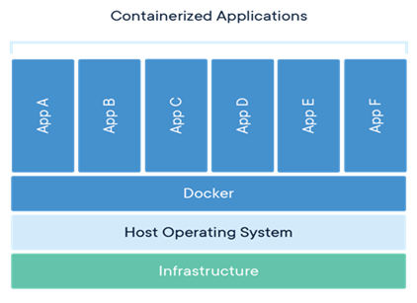
Features that work with Applications
Ability to create a multi-machine, multi-platform-based computing cluster.
Non-GUI Server Core
https://www.altaro.com/msp-dojo/container-for-msps-part-1/

Slide 36
Features that work with Applications
Ability to create a multi-machine, multi-platform-based computing cluster.
Non-GUI Server Core
Linux configuration integration

Slide 37
Features that work with Applications
Ability to create a multi-machine, multi-platform-based computing cluster.
Non-GUI Server Core
Linux configuration integration
A whole new way of managing cross-platform enterprise environments

Slide 38
Conclusion
Microsoft has brought a lot of advanced features to the market with the release of the new Windows Server 2019.
Infrastructure
Increased Integration
Security

Slide 39
https://www.youtube.com/watch?v=3wvTYbnXyB4

Slide 40
Questions?

